Slide 1
Grafică asistată de calculator
Laborator – Grigore Ionuț

Slide 2
Laboratory 8
Text-to-Image
Generation with
Latent Diffusion

Slide 3
Lab Overview
01
VAE: Compress & Reconstruct
02
CLIP Text Conditioning
Encode 512×512 images to 4×64×64 latent vectors. Decode them back and compare to originals.
Tokenise prompts to 77 tokens with the CLIP tokeniser. Encode with the CLIP text encoder to get context vectors.
03
Latent Space Diffusion
04
VAE Decode to 512×512
Start from pure noise in 4×64×64. Run 50 DDPM denoising steps guided by text context.
Use the VAE decoder to convert the clean latent into a full-resolution 512×512 color image.
05
Image Modification
06
CFG Scale Effects
Modify an existing image using a text prompt, controlling how much the output changes from the original.
Explore how guidance strength affects the balance between prompt fidelity and image diversity.

Slide 4
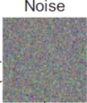
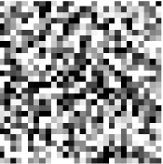
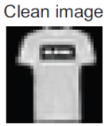
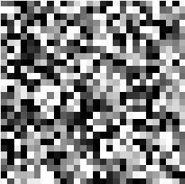



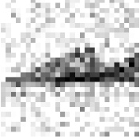


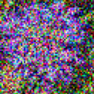

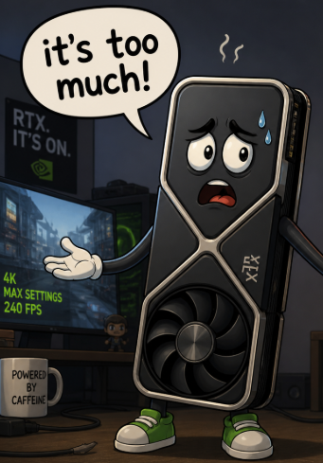
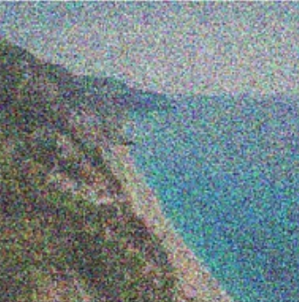

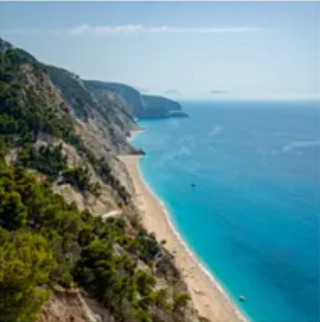


Context — From Pixel Space to Latent Space
...
▸ Grayscale 28×28 Fashion MNIST images
1×28×28 = 784 pixel values
Labs 4 & 5
Lab 6
...
▸ Color 64×64 Oxford Flowers images
3×64×64 = 12 288 pixel values
…but what if we want to generate color 512x512 images?
...
3×512×512 = 786 432 pixel values

Slide 5
Section 1
Variational
Autoencoder
(VAE)

Slide 6
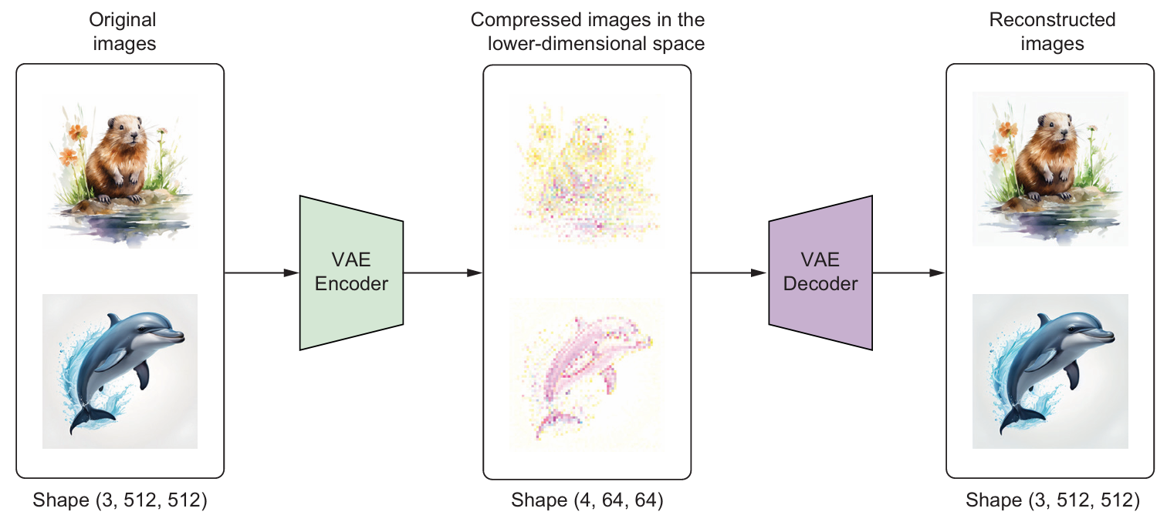
What is a VAE and Why Do We Need It?
A Variational Autoencoder compresses images into a small latent vector and reconstructs them back — losslessly.
Why latent space? Diffusion on 3×512×512 (786 432 values) is 48× slower than on 4×64×64 (16 384 values).

Slide 7
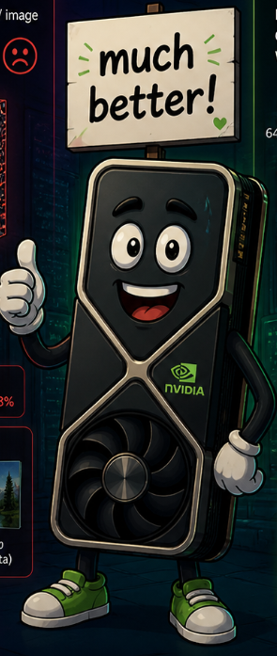

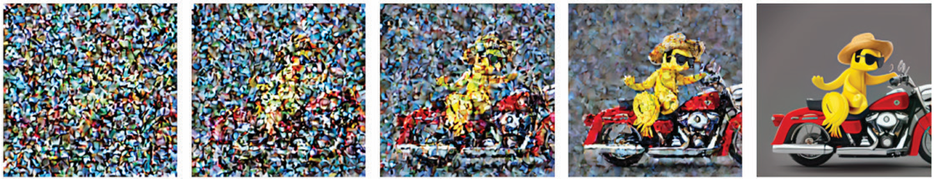
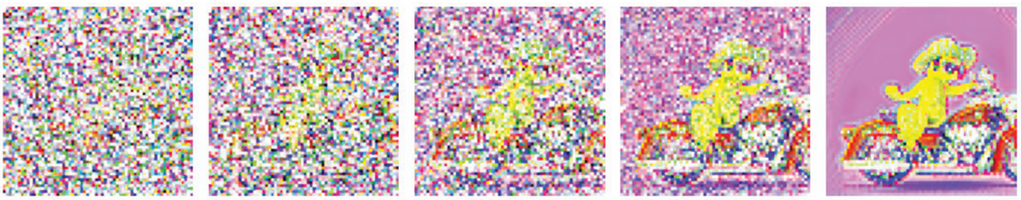
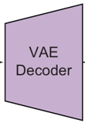
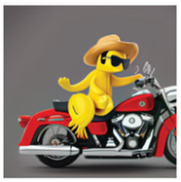
What is a VAE and Why Do We Need It?
A Variational Autoencoder compresses images into a small latent vector and reconstructs them back — losslessly.
Why latent space? Diffusion on 3×512×512 (786 432 values) is 48× slower than on 4×64×64 (16 384 values).
Instead of this …
pixel space
… we do this
latent space
pixel space

Slide 8
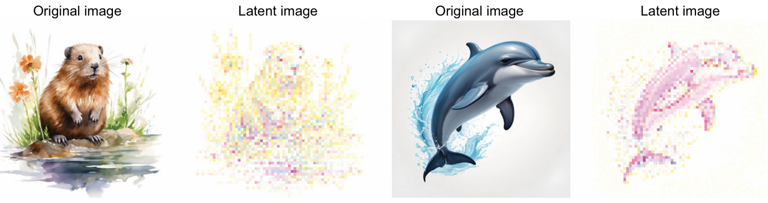
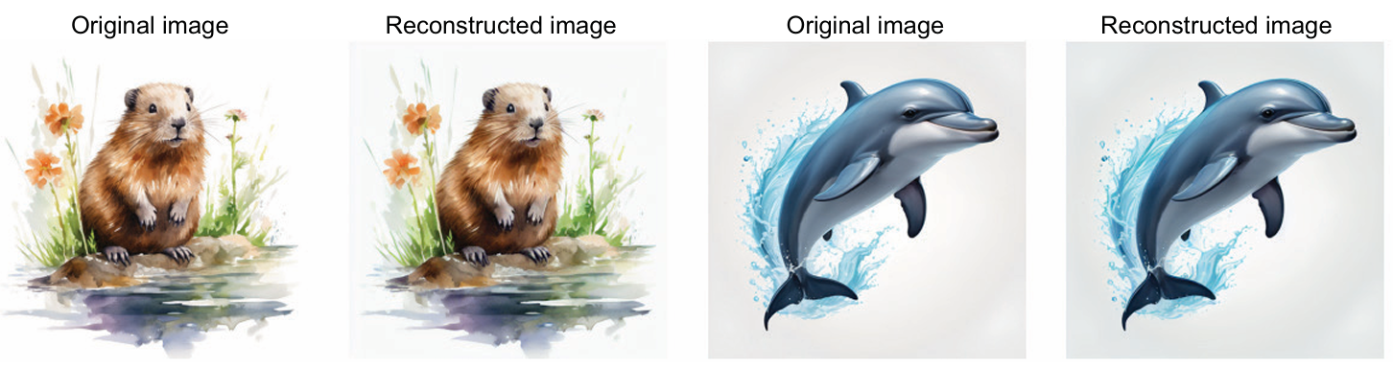
Encoding and Decoding in Practice
The 4 latent channels
The latent has 4 channels and is 8× smaller in each spatial dimension. Visually it looks like a blurry, abstract version of the original.
Unlike the 3 RGB channels of an image, the 4 latent channels are learned features — not interpretable as colours but rich in semantic content.
Reconstruction is nearly identical
The original and reconstructed images look the same to the human eye, proving the VAE captures all essential visual information.
The VAE's loss combines pixel reconstruction error (L2) and KL divergence. After training on millions of images, very little information is lost.

Slide 9
Section 2
Text Conditioning
with CLIP

Slide 10
CLIP Tokeniser and Text Encoder
Process conditional and unconditional prompts through CLIP, producing two context tensors that are stacked to guide the diffusion model
conditional prompt
unconditional prompt
"A banana riding a motorcycle, wearing sunglasses and a straw hat, highly detailed, ultra sharp, cinematic, 100mm lens, 8k resolution"
""
CLIP Tokeniser
CLIP Tokeniser
…
- vector with 77 elements
…
- vector with 77 elements
CLIP Text Encoder
…
…
…
- shape (1, 77, 768)
…
- shape (1, 77, 768)
…
…
conditional context
unconditional context
context = concat([conditional context, unconditional context])
- shape (2, 77, 768)

Slide 11
But why conditional and unconditional ?

Slide 12
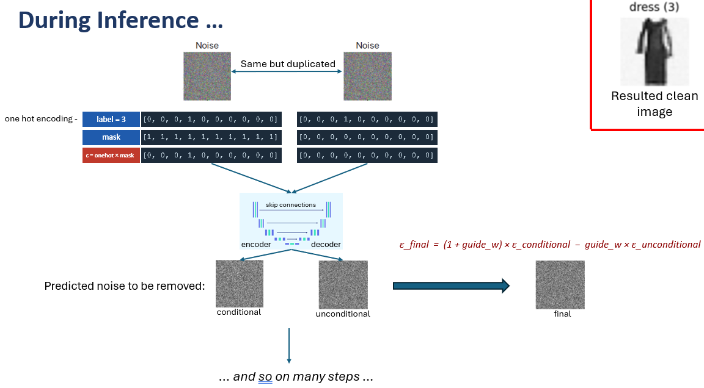
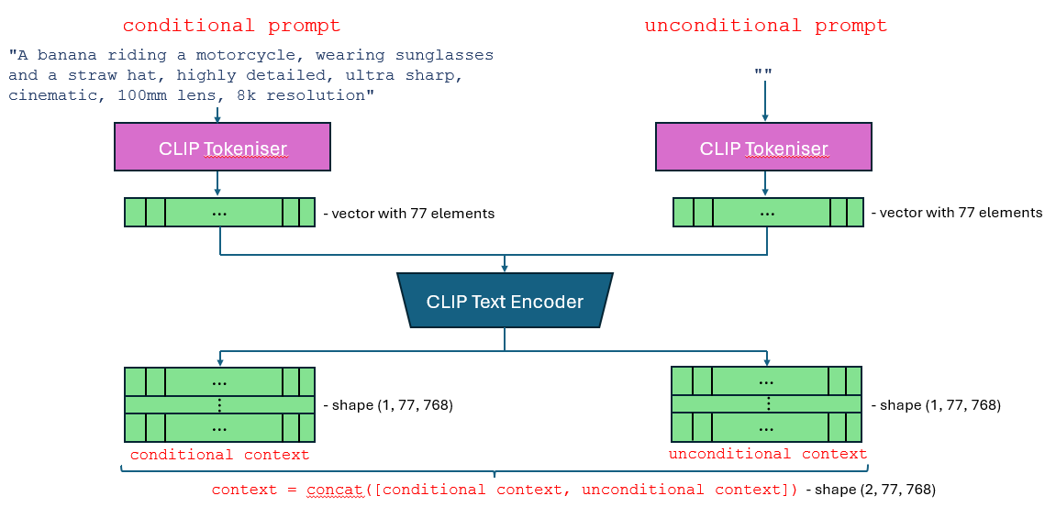
Remember this from lab 5 ?
This is him now.
Feel old yet?

Slide 13
Section 3
Latent Diffusion:
Generating Images
from Text

Slide 14
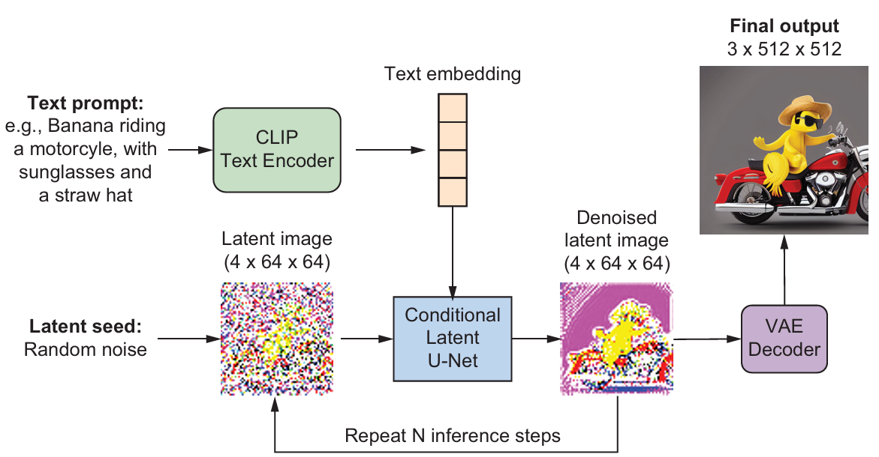
Diffusion in the Latent Space
DDPM denoising steps on 4×64×64, then decode to 512×512.

Slide 15
Section 4
Modifying Images
with Text Prompts

Slide 16
Modifying Existing Images with the strength Parameter
Encode an existing image to latent space, add noise, then denoise with a new text prompt.

Slide 17
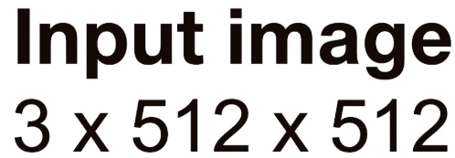
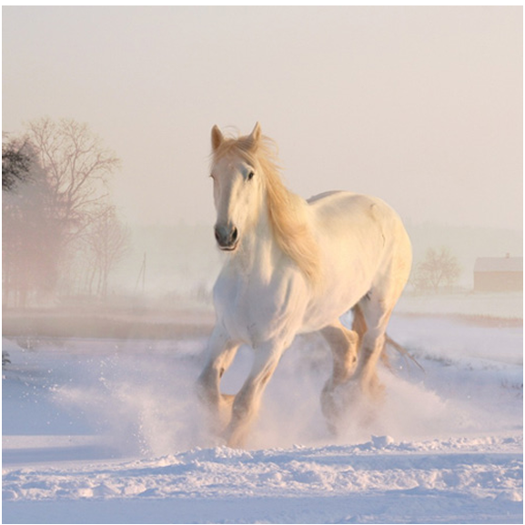

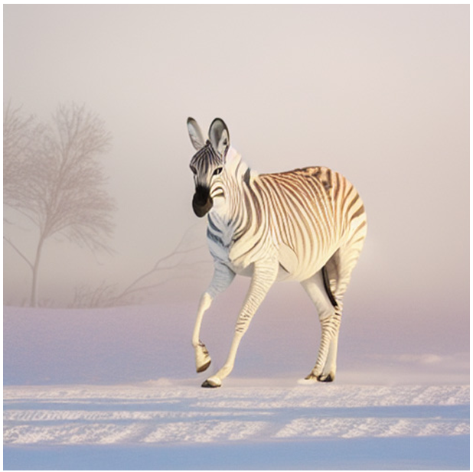

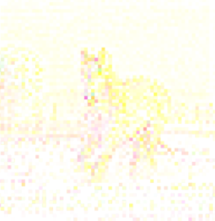
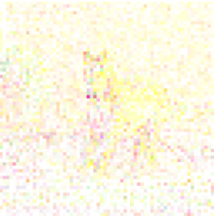
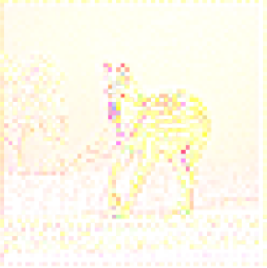


















Modifying Existing Images with the strength Parameter
Key difference from text-to-image generation: instead of starting from pure noise, we start from the encoded image with a controlled amount of noise added. The strength parameter determines how far the result can deviate from the original.
a zebra walks on the white, snow-covered ground
VAE Encoder
Random noise (4 x 64 x 64)
amount controlled by strength parameter

Slide 18
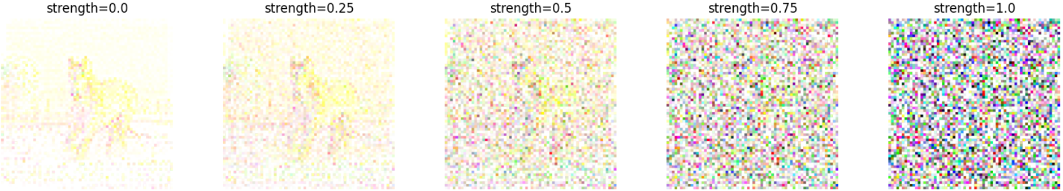
Modifying Existing Images with the strength Parameter
VAE Encoder
amount controlled by strength parameter
Random noise (4 x 64 x 64)

Slide 19
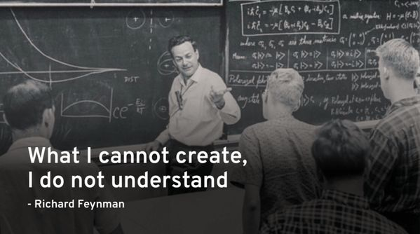

Slide 20
Exercises
01
Load & crop bird.png and cat.png
02
Encode image3 and image4 with VAE
Apply center_crop() and resize to 512×512. Name them image3 and image4. Print shapes.
Use the pretrained VAE encoder to compress both images to the latent space (4×64×64). Name them latent3 and latent4.
Hint: Expected: both torch.Size([3, 512, 512]).
Hint: Same noise tensor as used for the beaver/dolphin encoding.
03
Plot originals vs latents in 1×4 grid
04
Decode latent3 & latent4, compare
Place image3, latent3, image4, latent4 in a list. Plot in a 1×4 grid. Label each as 'original image' or 'latent image'.
Use VAE decoder on latent3 and latent4. Name them reconstruct3 and reconstruct4. Plot originals vs reconstructed in a 1×4 grid.
Hint: Repeat the latent pixels ×8 in each direction (numpy .repeat) so all 4 images are the same display size.
Hint: torch.clip(reconstruct[0].permute(1,2,0), 0, 1).detach().cpu().numpy() gives the plottable array.
05
Modify horse with dog prompt (strength=0.5)
06
Repeat exercise 5 with cfg_scale=5
Prompt: 'A dog walks on the white, snow-covered ground'. Use strength=0.5, cfg_scale=8, seed=42. Plot the output.
Use the same settings as exercise 5 but set cfg_scale=5. Compare the result to cfg_scale=8.
Hint: Call pipeline.generate() with the horse image as input_image. Changing only the prompt turns the horse into a dog.
Hint: Lower cfg_scale → less prompt adherence. The dog may look less convincing but the output will be more diverse.

Slide 21

⚠️ Note on Image Dimensions
The lab materials reference image dimensions of 512×512 (pixel space) and 64×64 (latent space).
However, the code uses 128×128 and 16×16 respectively, due to memory constraints in Google Colab.
For the Image Modification section, you may need to restart the runtime to free up memory before proceeding.
The larger dimensions are conceptually correct — we simply cannot use them here due to hardware limitations. We apologize for the inconvenience!

Slide 22
Ex 1
Load & crop bird.png and cat.png
❓ Download the two image files, bird.png and cat.png, and place them in the files folder. Apply the center_crop() function on them, and then resize them to a size of 3×512×512 . Name them image3 and image4, respectively. Print out the shape of the two processed images.
from PIL import Image
from torchvision import transforms
def center_crop(img): # same function from section 1
width, height = img.size
new = min(width, height)
left = (width - new) / 2
top = (height - new) / 2
right = (width + new) / 2
bottom = (height + new) / 2
return img.crop((left, top, right, bottom))
transform = transforms.ToTensor()
image3 = center_crop(Image.open("files/bird.png")).resize((512, 512))
image4 = center_crop(Image.open("files/cat.png" )).resize((512, 512))
image3 = transform(image3)
image4 = transform(image4)
print(image3.shape, image4.shape)
Expected output torch.Size([3, 512, 512]) torch.Size([3, 512, 512])

Slide 23
Ex 2
Encode image3 and image4 with VAE
❓ Use the VAE encoder to compress the two images, image3 and image4, to the latent space so that they have a shape of 4×64×64 . Name the two latent images latent3 and latent4.
import torch
# Reuse the same noise tensor used in section 1.2 (shape 1×4×64×64)
N = torch.distributions.Normal(0, 1)
noise = N.sample(torch.Size([1, 4, 64, 64]))
latent3 = encoder(image3.unsqueeze(0), noise)[0] # add batch dim → encode → remove batch
latent4 = encoder(image4.unsqueeze(0), noise)[0]
print(latent3.shape, latent4.shape)
Expected output torch.Size([4, 64, 64]) torch.Size([4, 64, 64])

Slide 24
Ex 3
Plot originals vs latents in 1×4 grid
❓ Plot the two original images, image3 and image4, and the two latent images, latent3 and latent4, in a 1×4 grid to compare them.
import matplotlib.pyplot as plt
import numpy as np
imgs = [
image3.permute(1, 2, 0), # original bird (512×512×3)
torch.clip(latent3.permute(1, 2, 0), -1, 1) # bird latent (64×64×4)
.detach().cpu().numpy()
.repeat(8, axis=0) # upsample ×8 → 512×512
.repeat(8, axis=1)[:, :, :3] / 2 + 0.5, # show first 3 channels, shift to [0,1]
image4.permute(1, 2, 0), # original cat
torch.clip(latent4.permute(1, 2, 0), -1, 1).detach().cpu().numpy().repeat(8, axis=0).repeat(8, axis=1)[:, :, :3] / 2 + 0.5,
]
plt.figure(figsize=(12, 3), dpi=100)
for i in range(4):
plt.subplot(1, 4, i + 1)
plt.imshow(imgs[i])
plt.title("original image" if i % 2 == 0 else "latent image")
plt.axis("off")
plt.tight_layout()
plt.show()

Slide 25
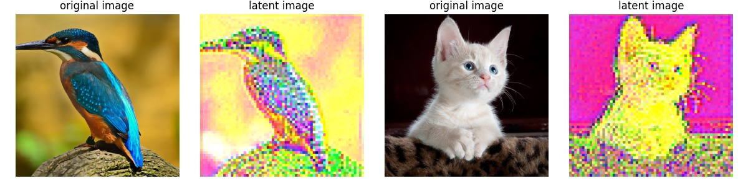
Ex 3
Plot originals vs latents in 1×4 grid
❓ Plot the two original images, image3 and image4, and the two latent images, latent3 and latent4, in a 1×4 grid to compare them.

Slide 26
Ex 4
Decode latent3 & latent4, compare
❓ Use the pretrained VAE decoder to convert the two latent images, latent3 and latent4, into two high-dimensional images. Name them reconstruct3 and reconstruct4, respectively. Then, plot the two original images, image3 and image4, and the two reconstructed images in a 1×4 grid to compare them.
reconstruct3 = decoder(latent3.unsqueeze(0)) # (1, 3, 512, 512)
reconstruct4 = decoder(latent4.unsqueeze(0))
print(reconstruct3.shape, reconstruct4.shape)
# ── Plot originals vs reconstructed ───────────────────────────────────────
imgs = [
image3.permute(1, 2, 0),
torch.clip(reconstruct3[0].permute(1, 2, 0), 0, 1).detach().cpu().numpy(),
image4.permute(1, 2, 0),
torch.clip(reconstruct4[0].permute(1, 2, 0), 0, 1).detach().cpu().numpy(),
]
plt.figure(figsize=(12, 3), dpi=100)
for i in range(4):
plt.subplot(1, 4, i + 1)
plt.imshow(imgs[i])
plt.title("original image" if i % 2 == 0 else "reconstructed image")
plt.axis("off")
plt.tight_layout()
plt.show()

Slide 27
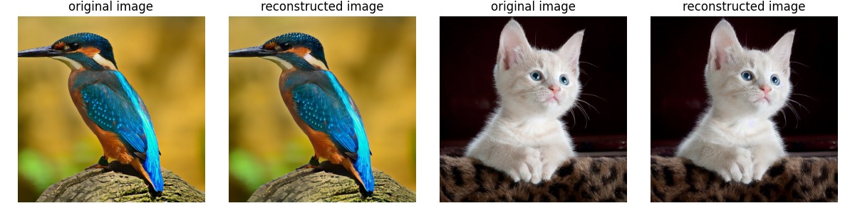
Ex 4
Decode latent3 & latent4, compare
❓ Use the pretrained VAE decoder to convert the two latent images, latent3 and latent4, into two high-dimensional images. Name them reconstruct3 and reconstruct4, respectively. Then, plot the two original images, image3 and image4, and the two reconstructed images in a 1×4 grid to compare them.

Slide 28
Ex 5
Modify horse with dog prompt (strength=0.5)
❓ Use “A dog walks on the white, snow-covered ground” as the prompt to modify the existing horse image. Set the strength parameter to 0.5, the cfg_scale parameter to 8, and the random state number (i.e., the seed argument in the generate() function) to 42. Plot the generated image.
models = model_loader.preload_models_from_standard_weights("files/hollie-mengert.ckpt", device)
input_image = Image.open("files/horse.png") # original horse image
uncond_prompt = ""
prompt = "A dog walks on the white, snow-covered ground."
output_image = pipeline.generate(
prompt = prompt,
uncond_prompt = uncond_prompt,
input_image = input_image,
strength = 0.5, # use 50% of denoising schedule
do_cfg = True,
cfg_scale = 8, # standard guidance
sampler_name = "ddpm",
n_inference_steps = 50,
seed = 42,
models = models,
device = device,
idle_device = "cpu",
tokenizer = tokenizer,
)
plt.figure(figsize=(5, 5), dpi=100)
plt.imshow(output_image)
plt.axis("off")
plt.tight_layout()
plt.show()

Slide 29
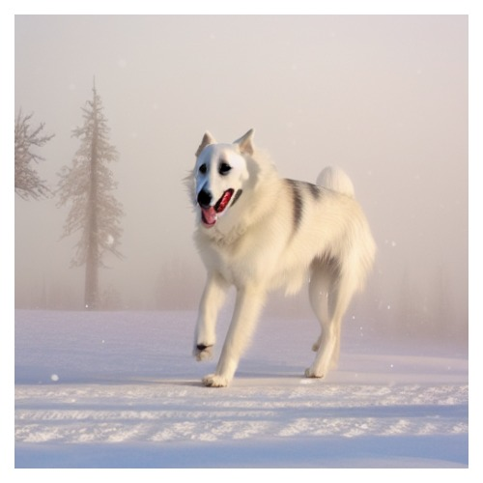
Ex 5
Modify horse with dog prompt (strength=0.5)
❓ Use “A dog walks on the white, snow-covered ground” as the prompt to modify the existing horse image. Set the strength parameter to 0.5, the cfg_scale parameter to 8, and the random state number (i.e., the seed argument in the generate() function) to 42. Plot the generated image.

Slide 30
Ex 6
Repeat exercise 5 with cfg_scale=5
❓ Change the cfg_scale parameter to 5 in the last code cell, and check to see what the output looks like.
prompt = "A dog walks on the white, snow-covered ground."
output_image_cfg5 = pipeline.generate(
prompt = prompt,
uncond_prompt = uncond_prompt,
input_image = input_image, # same horse.png
strength = 0.5, # same
do_cfg = True,
cfg_scale = 5, # ← ONLY CHANGE: 8 → 5
sampler_name = "ddpm",
n_inference_steps = 50,
seed = 42, # same seed
models = models,
device = device,
idle_device = "cpu",
tokenizer = tokenizer,
)
plt.figure(figsize=(5, 5), dpi=100)
plt.imshow(output_image_cfg5)
plt.axis("off")
plt.tight_layout()
plt.show()

Slide 31
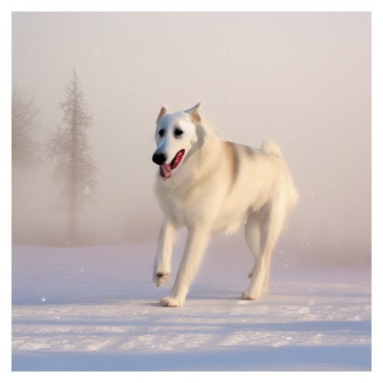
Ex 6
Repeat exercise 5 with cfg_scale=5
❓ Change the cfg_scale parameter to 5 in the last code cell, and check to see what the output looks like.

Slide 32
Thank you !

